Slide 1
SQL Joins

Slide 2
What is Joins ?
SQL Join statement is used to combine data or rows from two or more tables based on a common field between them
These Are Types of joins
Inner Join
Left Join
Right Join
Full Join

Slide 3
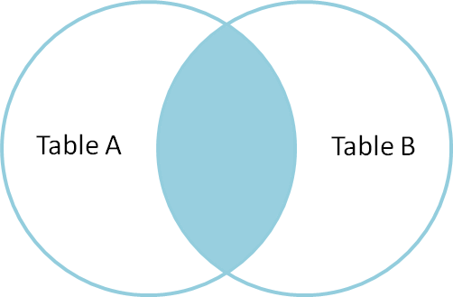
Inner Join
The INNER JOIN keyword selects all rows from both the tables as long as the condition is satisfied.
Its most popular form of join and assumes as a default join.
SELECT columns
FROM table1
INNER JOIN table2 ON condition1
INNER JOIN table3 ON condition2

Slide 4
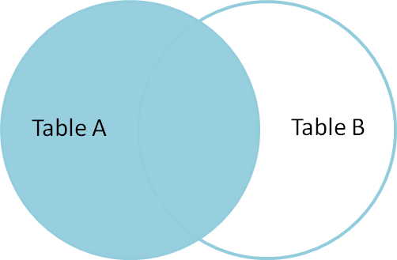
Left Join
Left Join returns all records from the left table, and the matched records from the right table
It will return NULL when no matching record is found in the right side table.
SELECT column_lists
FROM table1
LEFT [OUTER] JOIN table2
ON table1.column = table2.column;

Slide 5
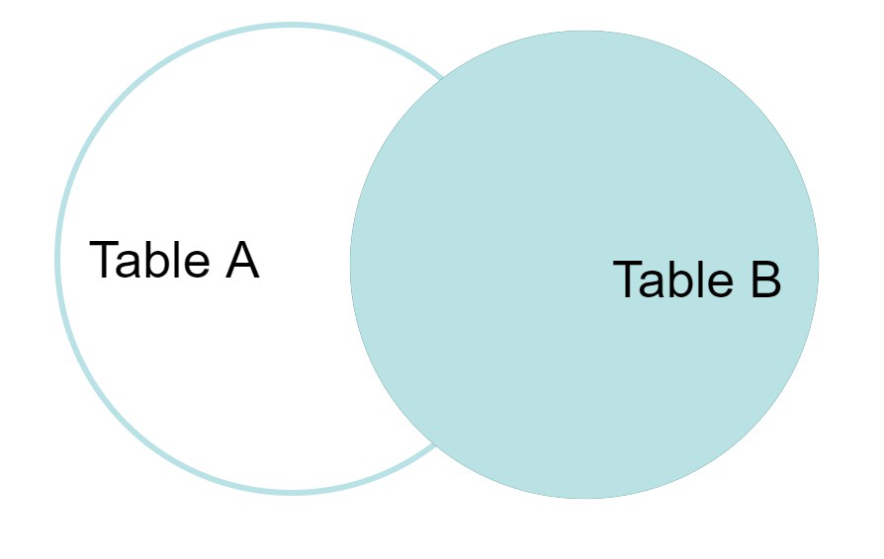
Right Join
The RIGHT OUTER JOIN retrieves all the records from the right-hand table and matched rows from the left-hand table.
For the rows for which there is no matching row on the left side, the result-set will contain null.
SELECT column_lists
FROM table1
RIGHT [OUTER] JOIN table2
ON table1.column = table2.column;

Slide 6
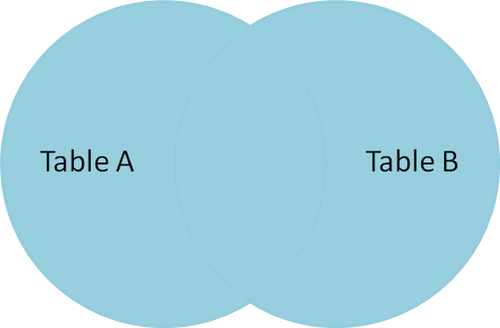
Full Join
The FULL OUTER JOIN in SQL Server returns a result that includes all rows from both tables.
FULL JOIN creates the result-set by combining results of both LEFT JOIN and RIGHT JOIN. The result-set will contain all the rows from both tables
SELECT column_lists
FROM table1
FULL [OUTER] JOIN table2
ON table1.column = table2.column;

